Slide 1
World Development Report 2019
The changing nature of work
social protection and labor Polices
Simeon Djankov
Vilnius, Lithuania
July 9th, 2018

Slide 2
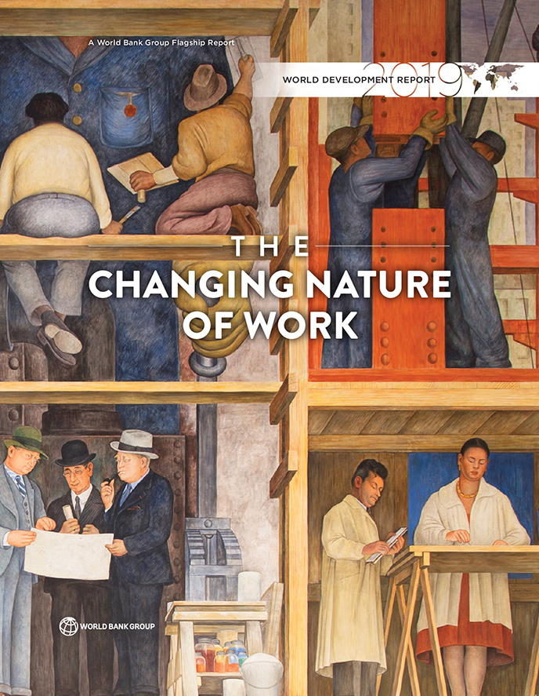
An Open Source and Transparent Process
Weekly updated drafts:
http://www.worldbank.org/en/publication/wdr2019
130,000 downloads of the draft as of July 6th, 2018
The Report will be published in October 2018.

Slide 3
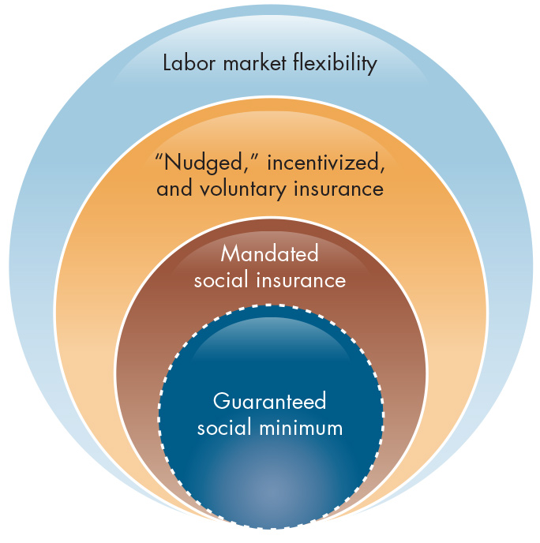
Stronger Social Protection and Labor Market Flexibility
Social Assistance (guaranteed social minimum)
Social Insurance
Labor Institutions
Source: Adapted from World Bank 2018c.

Slide 4
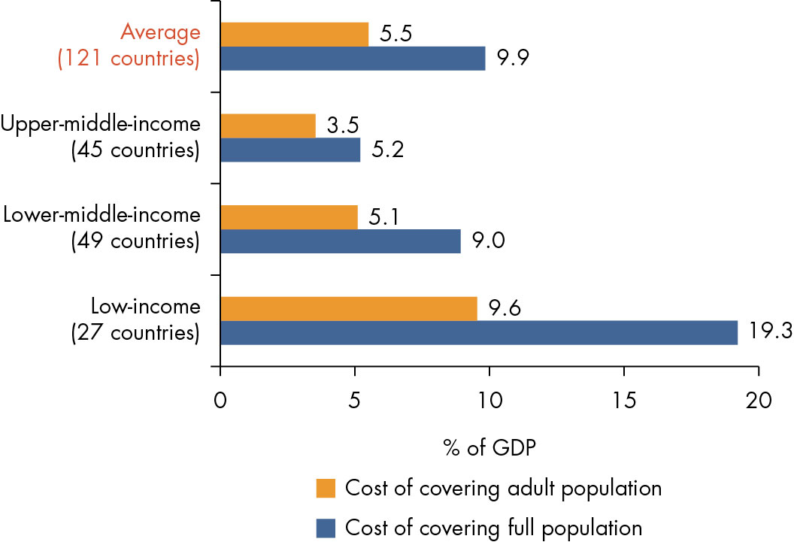
Expanded Social Assistance is Needed but it is Costly
Only 19% of population in the poorest quintile in LICs being covered by social assistance
Significant additional spending is required for a UBI
Source: Authors’ calculations based on World Bank World Development Indicators, World Bank PovcalNet, and United Nations World Population Prospects.

Slide 5
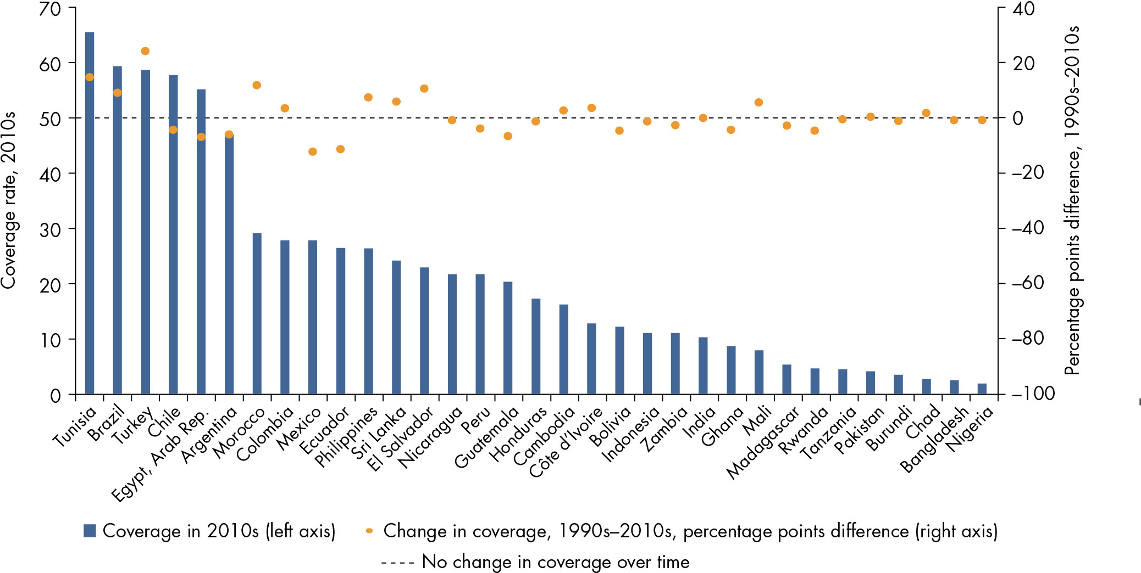
Coverage of Social Insurance Remains Low
Source: Authors’ calculations based on World Bank pension database and World Development Indicators.

Slide 6
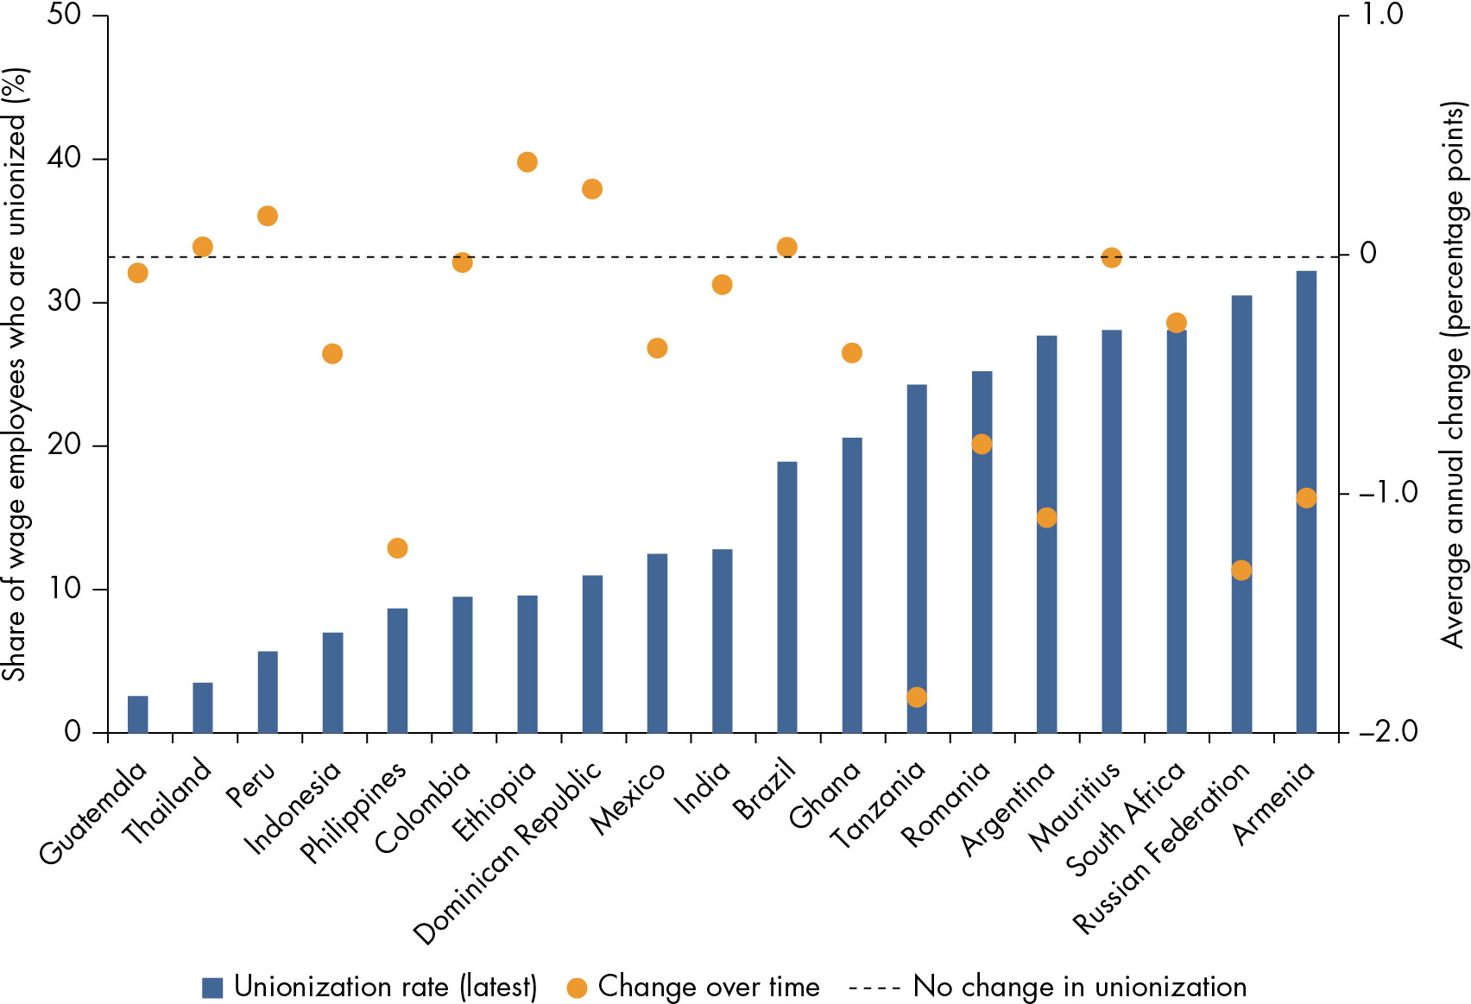
Rates of Unionization Are Low and Declining in Many Developing Countries
Source: Authors’ calculations, based on ILOSTAT.

Slide 7
Complementing Strong Social Protection with Labor Market Flexibility
Challenges
Labor regulations often reduce dynamism in the economy
Actions
Rethink minimum wage
Strengthen bargaining power of workers
Balance between workers’ protection and firm’s flexibility
Flexibility by firms in managing their human resources
Informality

Slide 8
http://www.worldbank.org/en/publication/wdr2019

